Slide 1




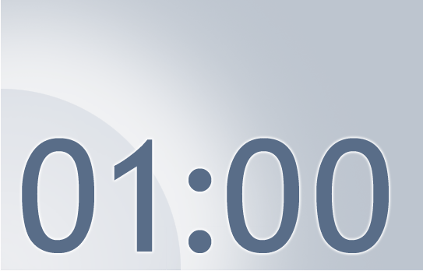

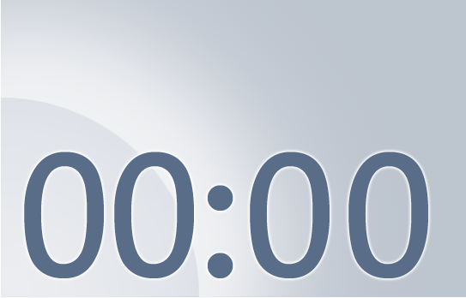
To start the timer, on the Slide Show menu, click View Show.
Delete this textbox before using this slide in a presentation.
Notes:
Using this PowerPoint break timer
This PowerPoint slide uses images, custom animation, and timing to provide a countdown timer that you can use in any presentation. When you open the template, you’ll notice that the timer is set at 00:00. However, when you start the slide show, the timer will start at the correct time and count down by 1-minute intervals until it gets to 1 minute. At that point, it will count down in two 30-seconds intervals to 00:00.
To insert this slide into your presentation
Save this template as a presentation (.ppt file) on your computer.
Open the presentation that will contain the timer.
On the Slides tab, place your insertion point after the slide that will precede the timer. (Make sure you don't select a slide. Your insertion point should be between the slides.)
On the Insert menu, click Slides from Files.
In the Slide Finder dialog box, click the Find Presentation tab.
Click Browse, locate and select the timer presentation, and then click Open.
In the Slides from Files dialog box, select the timer slide.
Select the Keep source formatting check box. If you do not select this check box, the copied slide will inherit the design of the slide that precedes it in the presentation.
Click Insert.
Click Close.

